Slide 1
DETECTING DDoS ATTACK USING MACHINE
LEARNING ALGORITHM
Name : Fathimath Suhara M A
Roll No : 18
Product Owner : Dr Geevar C Zacharias

Slide 2
Table of Contents
Introduction
Modules
3. Developing Environment
4. Methodology
5. Classifiers
6. Results
7. Future Enhancements
8. Project Plan
9. User Story
10. Product Backlog
11. Sprint Plan
12. Sprint Actuals

Slide 3
INTRODUCTION
Distributed denial-of-service attack, also known as DDoS attack, is one of the most common network attacks at present. With the rapid
development of computer and communication technology, the harm of DDoS attack is becoming more and more serious.
Therefore, the research on DDoS attack detection becomes more important.
II. This type of attack takes advantage of the specific capacity limits that apply to any network resources – such as the infrastructure that enables
a company’s website. The DDoS attack will send multiple requests to the attacked web resource – with the aim of exceeding the website’s
capacity to handle multiple requests… and prevent the website from functioning correctly.
III. In view of this, this paper proposes a DDoS attack detection method based on machine learning, which includes two steps: feature
extraction and model detection.
In the feature extraction stage, the DDoS attack traffic characteristics with a large proportion are extracted by comparing the data
packages classified according to rules.
In the model detection stage, the extracted features are used as input features of machine learning, and various machine learning
algorithms are used to train the detection model.
IV. The experimental results show that the proposed DDoS attack detection method based on machine learning has a good detection rate for the
current popular DDoS attack.

Slide 4
How a DDoS attack works
Network resources – such as web servers – have a finite limit to the number of requests that they can service simultaneously. In addition to
the capacity limit of the server, the channel that connects the server to the Internet will also have a finite bandwidth / capacity. Whenever
the number of requests exceeds the capacity limits of any component of the infrastructure, the level of service is likely to suffer in one of
the following ways:
* The response to requests will be much slower than normal.
* Some – or all – users’ requests may be totally ignored.
Usually, the attacker’s ultimate aim is the total prevention of the web resource’s normal functioning – a total ‘denial of service’. The attacker
may also request payment for stopping the attack. In some cases, a DDoS attack may even be an attempt to discredit or damage a competitor’s
business.
Using a Botnet ‘zombie network’ to deliver a DDoS attack
In order to send an extremely large number of requests to the victim resource, the cybercriminal will often establish a ‘zombie network’ of
computers that the criminal has infected. Because the criminal has control over the actions of every infected computer in the zombie network,
the sheer scale of the attack can be overwhelming for the victim’s web resources.

Slide 5
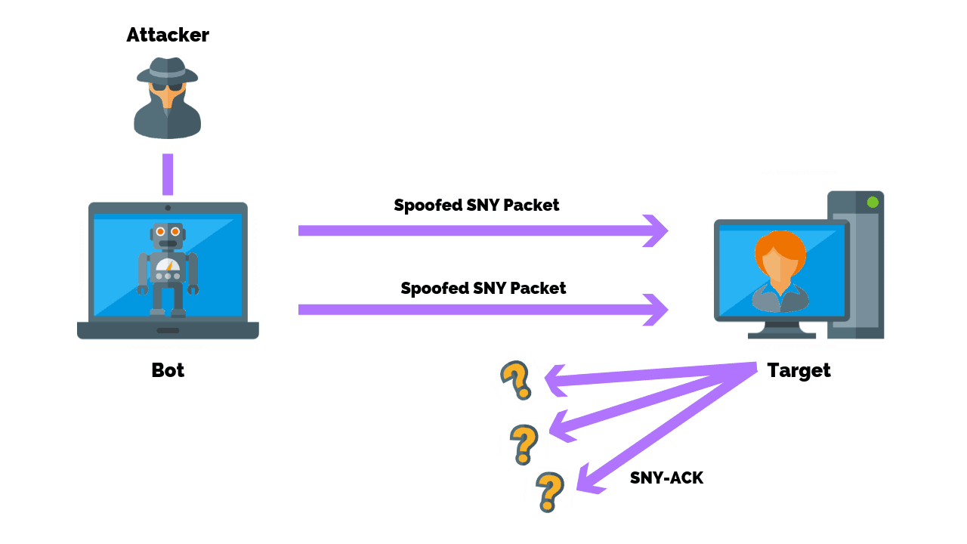

Slide 6
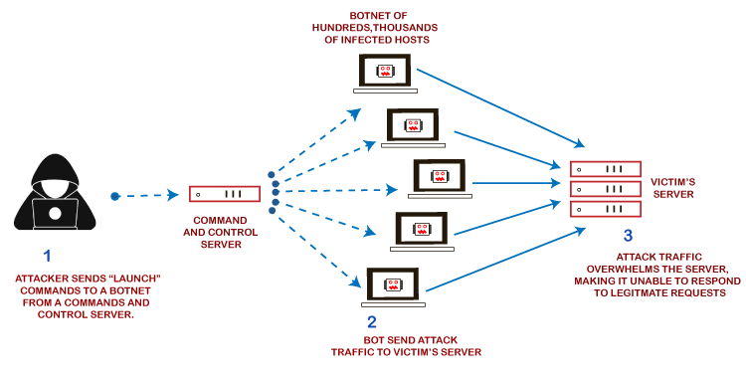

Slide 7
MODULES
1.Data collection
2.Data Cleaning
3.Data Preprocessing
4.Training
5.Testing
6.Result Generation

Slide 8
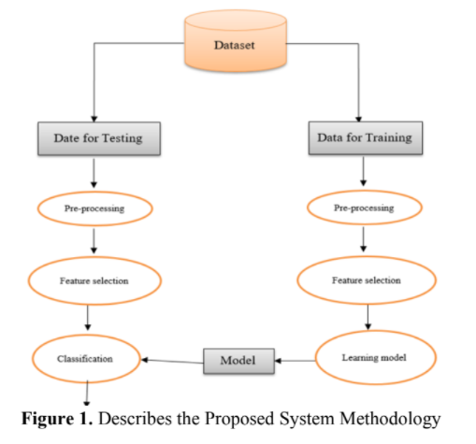

Slide 9
DEVELOPING ENVIRONMENT
Hardware Specification :
Processor : Intel Pentium Core i3 and above
Primary Memory : 4 GB RAM and above
Storage : 500 GB hard disk and above
Display : VGA Color Monitor
Key Board : Windows compatible
Mouse : Windows compatible
Software Specification :
Language : Python
Front end : Python Django
Back end : SQLite
Operating system : windows 7 and above
IDE : Jupyter Notebook(Anaconda)
Classifier : KNN Algorithm, Logistic Regression Algorithm, Decision Tree Algorithm and MLP Classifier

Slide 10
Dataset : DDoS Dataset from Kaggle Website
Process:
First, take the particular Dataset and import it to the Jupyter Notebook. Later by using the machine learning algorithms we can obtain
the accuracy of the prediction of DDoS attacks.

Slide 11
METHODOLOGY
Our objective is to find the best Machine Learning Algorithms for the detection of ddos attack. Then the best
performing model will be saved and will be linked to a user interface by which it can predict new input data . To achieve this objective training
data have to go through various intermediate processes before giving it to Algorithms. The main parameters on which the performance of the
model will be judge are accuracy of the model.
1. Data Collection
Data is the prime ingredient of this project, as these data features are various machine learning algorithms. By using these features
of the data, Machine Learning Algorithms are trained and models are created. In this proposal, we have taken a ddos attack dataset with 3,11,029
data points and 49 features from Kaggle Website . This data set is divided in the ratio of 70:30 for training and testing of algorithms.
2 .Data Cleaning
Data set is a chunk of data that is in raw form. It may contain certain symbols like digits, special characters, blank lines, and data without any
label. These symbols should be removed as it is of no importance and it can also affect the performance of the model in an adverse manner.

Slide 12
3. Data Preprocessing
After data cleaning, data is now free of unwanted symbols. This data should be converted into the form which can be used for extracting the features
easily. It eliminates the null values.
4. Feature Selection
Feature Selection is the process where we select those features which contribute most to your prediction variable or output. Certain features are present
in ddos attack, we have to extract them and accordingly, our classier is trained to predict the ddos attack. For analysis and classification problems we
have used eight features including "duration","service","src_bytes","wrong_fragment","count","urgent","num_compromised","srv_count". 'duration' is
the time gap between sending a request from source port and receiving the request to the destination port, 'service' is the protocol type of the network,
'src_bytes' is the how much bytes of data are transfered, 'wrong_fragment, is how data packets or requests are failed, 'count' is the number of the failure
data packets, 'urgent' is the state of the data packet, 'num_compromised' is the details of the attacked data packets and 'srv_count' is the number of
affected data packets.

Slide 13
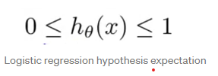
CLASSIFIERS
In our model, we used four types of machine learning algorithms and for the implementation work, we used the Jupyter notebook platform with the
assistance of Python programmable language. The classification models that we implemented using the above-mentioned dataset are Logistic
Regression, KNN Algorithm, Decision Tree and MLP Classifier. This algorithms are good for various classifications and that they got their own
properties and performance for supporting different datasets.
MODELS
1. Logistic Regression Algorithm
Logistic Regression is a Machine Learning algorithm which is used for the classification problems, it is a predictive analysis algorithm and based on
the concept of probability.We can call a Logistic Regression a Linear Regression model but the Logistic Regression uses a more complex cost
function, this cost function can be defined as the ‘Sigmoid function’ or also known as the ‘logistic function’ instead of a linear function.The hypothesis
of logistic regression tends it to limit the cost function between 0 and 1. Therefore linear functions fail to represent it as it can have a value greater
than 1 or less than 0 which is not possible as per the hypothesis of logistic regression.

Slide 14
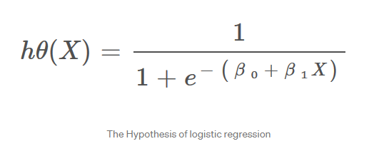
2. KNN Algorithm
K-Nearest Neighbour is one of the simplest Machine Learning algorithms based on Supervised Learning technique. K-NN algorithm assumes the
similarity between the new case/data and available cases and put the new case into the category that is most similar to the available categories.
K-NN algorithm stores all the available data and classifies a new data point based on the similarity. This means when new data appears then it can be
easily classified into a well suite category by using K- NN algorithm.
K-NN algorithm can be used for Regression as well as for Classification but mostly it is used for the Classification problems.
It is also called a lazy learner algorithm because it does not learn from the training set immediately instead it stores the dataset and at the time of
classification, it performs an action on the dataset. KNN algorithm at the training phase just stores the dataset and when it gets new data,
then it classifies that data into a category that is much similar to the new data.

Slide 15
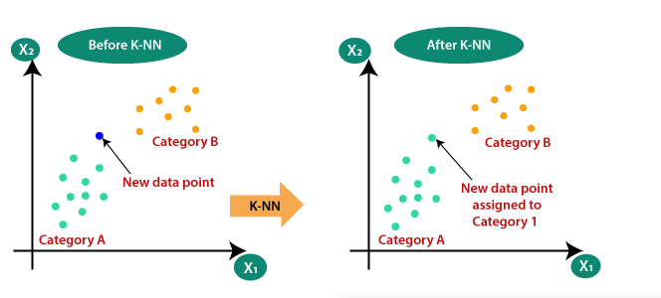
Why do we need a K-NN Algorithm?
Suppose there are two categories, i.e., Category A and Category B, and we have a new data point x1, so this data point will lie in which of these
categories. To solve this type of problem, we need a K-NN algorithm. With the help of K-NN, we can easily identify the category or class of a particular
dataset. Consider the below diagram:

Slide 16
3. Decision Tree Classification Algorithm
Decision Tree is a Supervised learning technique that can be used for both classification and Regression problems, but mostly it is preferred for
solving Classification problems. It is a tree-structured classifier, where internal nodes represent the features of a dataset, branches represent the
decision rules and each leaf node represents the outcome.In a Decision tree, there are two nodes, which are the Decision Node and Leaf Node.
Decision nodes are used to make any decision and have multiple branches, whereas Leaf nodes are the output of those decisions and do not contain
any further branches.The decisions or the test are performed on the basis of features of the given dataset.
.
It is a graphical representation for getting all the possible solutions to a problem/decision based on given conditions.It is called a decision tree
because,similar to a tree, it starts with the root node, which expands on further branches and constructs a tree-like structure.
In order to build a tree, we use the CART algorithm, which stands for Classification and Regression Tree algorithm.
A decision tree simply asks a question, and based on the answer (Yes/No), it further split the tree into subtrees.
Below diagram explains the general structure of a decision tree:

Slide 17
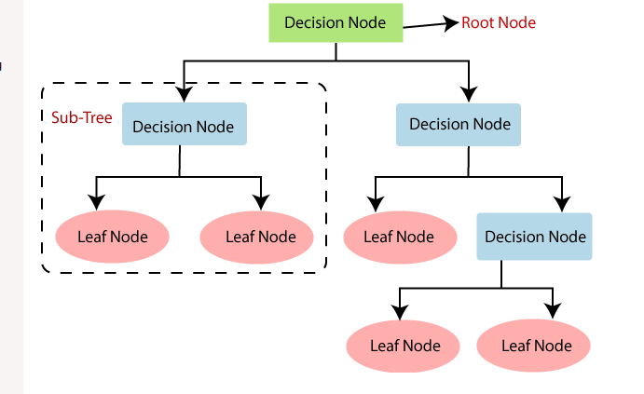
Why use Decision Trees?
There are various algorithms in Machine learning, so choosing the best algorithm for the given dataset and problem is the main point to remember
while creating a machine learning model. Below are the two reasons for using the Decision tree:
* Decision Trees usually mimic human thinking ability while making a decision, so it is easy to understand.
* The logic behind the decision tree can be easily understood because it shows a tree-like structure.

Slide 18
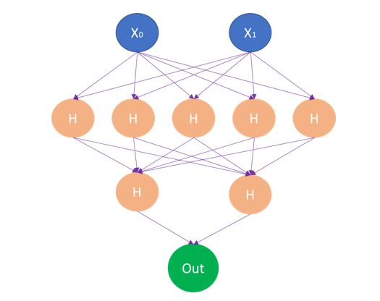
4. MLP Classifier
The multilayer perceptron (MLP) is a feedforward artificial neural network model that maps input data sets to a set of appropriate outputs. An MLP
consists of multiple layers and each layer is fully connected to the following one. The nodes of the layers are neurons with nonlinear activation
functions, except for the nodes of the input layer. Between the input and the output layer there may be one or more nonlinear hidden layers.

Slide 19
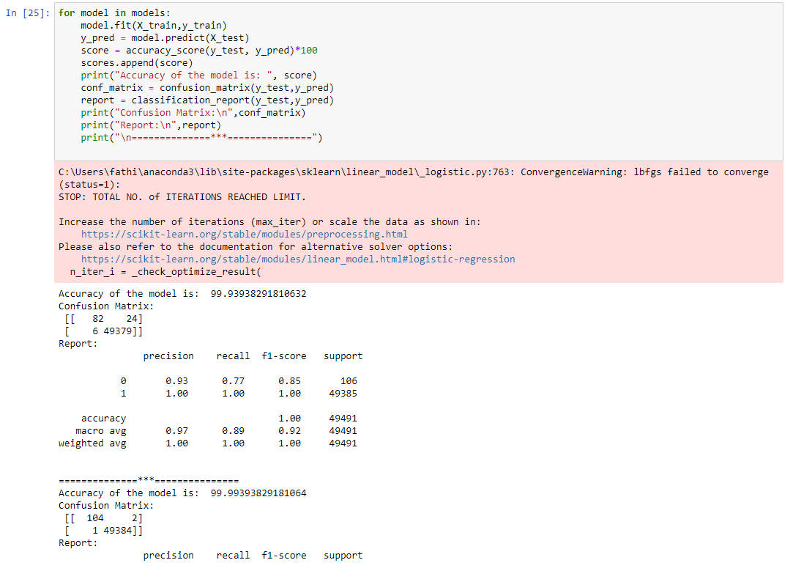
RESULTS

Slide 20
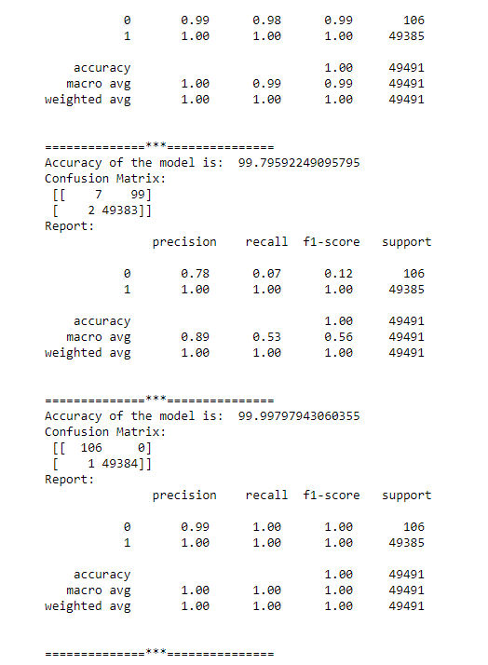

Slide 21
In this project,we use several machine learning algorithms to train a model which can be used to detect and classify the type of DDoS attack with
greater accuracy.The above figures shows each model give better accuracy for the detection of DDoS attacks.The effect of Denial of Services will be
detected by using this machine learning algorithms and the defect can be controlled by taking necessary precautions.

Slide 22
FUTURE ENHANCEMENTS
The future implementation will focuses on implementing 100% accuracy of the hybrid model.
To make a real time system analysis to curb the denial of services.

Slide 23
PROJECT PLAN
User Story ID | Task Name | Start Date | End Date | Days | Status
1 | Sprint 1 | 27/12/2021 | 27/12/2021 | 2 | Completed
2 |  | 28/12/2021 | 28/12/2021 |  | Completed
3 | Sprint 2 | 15/01/2022 | 16/01/2022 | 4 | Completed
4 |  | 22/01/2022 | 22/01/2022 |  | Completed
5 |  | 23/01/2022 | 23/01/2022 |  | Completed
6 |  | 26/01/2022 | 29/01/2022 |  | Completed
7 | Sprint 3 | 05/02/2022 | 06/02/2022 | 4 | Completed
8 |  | 12/02/2022 | 12/02/2022 |  | Completed

Slide 24
USER STORY
User Story ID | As a type of User | I Want To <Perform Some Task> | So that I can < Achieve Some Goal>
1 | User | Collection of datasets | DDoS Dataset
2 | User | Preprocessing of collected data (null value elimination) | Cleaned final dataset
3 | User | Collect IP Address,Port Number | Get IP Address and Port number
4 | User | Collect incoming packets | Get incoming packets
5 | User | Count the number of accesses or IP Address | Get the number of accesses
6 | User | Compare with dataset | Compare the number of access with the threshold
7 | User | Modelling the data | Apply ML Algorithms
8 | User | Output Generation | Detecting DDoS Attack Or No Attack

Slide 25
PRODUCT BACKLOG
User story ID | Priority <High/Medium/Low> | Size (Hours) | Sprint <#> | Status <Planned/In progress/Completed> | Release Date | Release Goal
1 | Medium | 2 | 1 | Completed | 27/12/2021 | Collection of datasets from Kaggle website
2 | Medium | 2 |  | Completed | 28/12/2021 | Preprocessing of collected data
3 | Medium | 5 | 2 | Completed | 15/01/2022 -16/012022 | Collect IP Address,Port No
4 | High | 10 |  | Completed | 22/01/2022 | Collect Incoming Data packets
5 | Medium | 5 |  | Completed | 23/01/2022 | Count number of accesses or IP Address
6 | High | 10 |  | Completed | 26/01/2022 - 29/01/2022 | Compare with dataset
7 | High | 6 | 3 | Completed | 06/02/2022 | Apply ML Algorithms
8 | High | 5 |  | Completed | 12/02/2022 | Output Generation

Slide 26
SPRINT PLAN
Backlog Item | Status& Completion | Original Estimate in hours | Day 1 | Day 2 | Day 3 | Day 4 | Day 5 | Day 6 | Day 7 | Day 8 | Day 9 | Day 10 | Day 11
User Story#1 |  | Hours | Hours | Hours | Hours | Hours | Hours | Hours | Hours | Hours | Hours | Hours | Hours
Dataset Collection | 27/12/2021 | 5 | 3 | 0 | 0 | 0 | 0 | 0 | 0 | 0 | 0 | 0 | 0
Preprocessing | 28/12/2021 | 5 | 0 | 2 | 0 | 0 | 0 | 0 | 0 | 0 | 0 | 0 | 0
User Story #2,3,4,5,6
Visualization & Training | 23/01/2022 | 10 | 0 | 0 | 4 | 4 | 2 | 0 | 0 | 0 | 0 | 0 | 0
User Story #7
UI Designing | 29/01/2022 | 12 | 0 | 0 | 0 | 0 | 0 | 4 | 4 | 4 | 0 | 0 | 0
User Story #8
Testing | 12/02/2022 | 18 | 0 | 0 | 0 | 0 | 0 | 0 | 0 | 0 | 6 | 6 | 6
Total |  | 50 | 5 | 5 | 4 | 4 | 2 | 4 | 4 | 4 | 6 | 6 | 6

Slide 27
SPRINT ACTUAL
Backlog Item | Status& Completion | Original Estimate in hours | Day 1 | Day 2 | Day 3 | Day 4 | Day 5 | Day 6 | Day 7 | Day 8 | Day 9 | Day 10 | Day 11 | Completed <Y/N>
User Story#1 |  | Hours | Hours | Hours | Hours | Hours | Hours | Hours | Hours | Hours | Hours | Hours | Hours
Data Collection | 27/12/2021 | 5 | 5 | 0 | 0 | 0 | 0 | 0 | 0 | 0 | 0 | 0 | 0 | Y
Preprocessing | 28/12/2021 | 5 | 0 | 5 | 0 | 0 | 0 | 0 | 0 | 0 | 0 | 0 | 0 | Y
User Story #2,3,4,5,6
Visualization & Training | 23/01/2022 | 10 | 0 | 0 | 4 | 4 | 2 | 0 | 0 | 0 | 0 | 0 | 0 | Y
User Story #7
UI Designing | 29/01/2022 | 12 | 0 | 0 | 0 | 0 | 0 | 4 | 4 | 4 | 0 | 0 | 0 | Y
User Story #8
Testing | 12/02/2022 | 18 | 0 | 0 | 0 | 0 | 0 | 0 | 0 | 0 | 6 | 6 | 6 | Y
Total |  | 50 | 5 | 5 | 4 | 4 | 2 | 4 | 4 | 4 | 6 | 6 | 6 | Y

Slide 28
THANK YOU

